Slide 1
Experimental Evidence on Adoption and Impact of the System of Rice Intensification
Christopher B. Barrett (Cornell), Asad Islam (Monash), Abdul Malek (Tsukuba), Deb Pakrashi (IIT Kanpur), and Ummul Ruthbah (Monash)
Virtual seminar hosted by Virginia Tech
January 27, 2021

Slide 2
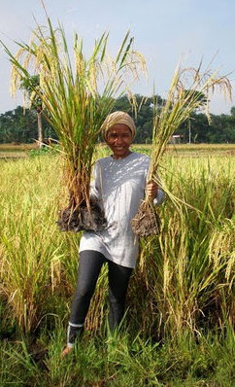
Specific Motivation: SRI Controversy
System of Rice Intensification(SRI) began in 1980s Madagascar.
Now diffused to >50 countries.
Involves change in multiple agronomic practices. Uses no new purchased inputs. So often billed as ‘pro-poor’, ‘sustainable’, or ‘low external input sustainable agriculture’.
A set of principles/practices more than an embodied technology.
Photo credit: SRI-RICE
http://sri.ciifad.cornell.edu/

Slide 3
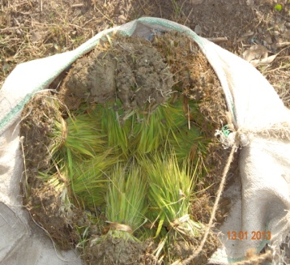
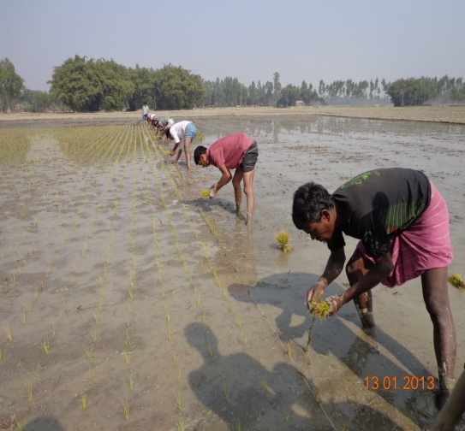
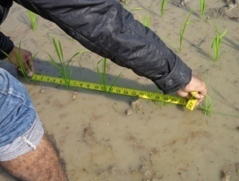
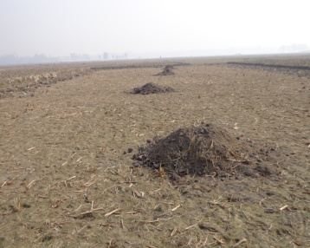
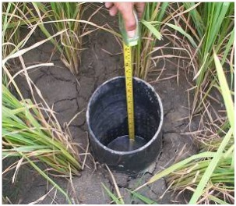
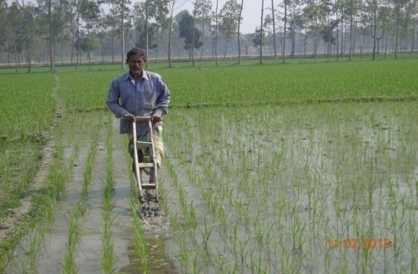
6 key SRI principles (BMPs) taught by BRAC
(3 key, differentiating, widely adopted practices in 1st row in bold)
Transplant seedlings @15-20 days (vs. 40-45 day)
1-2 seedlings per hill (vs. 4-5)
Wider spacing (25 × 20 cm) w/specific geometry (vs. no)
Use more organic fertilizer
Alternate wetting/drying (vs. continuously flooded)
Regular mechanical weeding (vs. chemicals)

Slide 4
What is the SRI Controversy?
Observational studies find big (30-80% yield/profit) gains.
Gains remain hotly disputed within rice science community (e.g., “Curiosity, Nonsense Non-science and SRI” or “Agronomic UFOs” both published in Field Crops Research).
Also, diffusion remains limited w/n countries and disadoption surprisingly high (often 15-40%). Casts doubts on gains.
To date, despite >1200 journal articles to date on SRI, no RCT to evaluate diffusion or farmer-managed gains.
Need to address/resolve lingering doubts about SRI.
Photo credit: SRI-RICE
http://sri.ciifad.cornell.edu/

Slide 5
Our contribution
BRAC fielded 1st large-scale, multi-year RCT on diffusion of and gains from SRI (in Bangladesh).
We find:
Modest (1 day) training on SRI induces significant uptake.
Uptake rises significantly w/ direct/indirect SRI tng exposure.
Exposure to SRI training significantly increases rice yields and profits, household well-being indicators.
ITT estimates are invariant wrt to level of exposure.
No GE effects on rice prices or wage rates.
High (40%) disadoption rates follow pre-exposure and post-adoption performance w/SRI.
Photo credit: SRI-RICE
http://sri.ciifad.cornell.edu/

Slide 6
Our contribution
We find:
Strong non-random selection into SRI adoption. Training scales uptake, not performance.
Seemingly-rational self-selection into/out of SRI, both in cross-section and over time.
A caution about heterogeneous treatments problems in information experiments: exposure affects performance of non-adopters (both exclusion restriction and SUTVA for LATE estimates).
A caution about dominant, target-input learning models (or any model of learning about a single, performance object) … but consistent w/more recent multi-object learning models. Learning at extensive/intensive margins different?
Photo credit: SRI-RICE
http://sri.ciifad.cornell.edu/

Slide 7
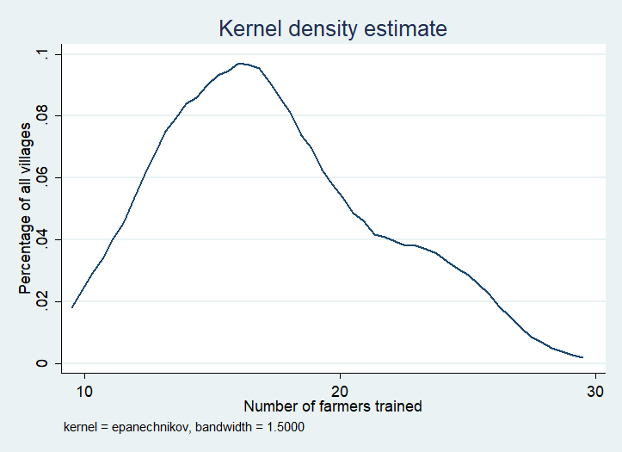
Multi-year randomized saturation RCT Design
120 training villages (5 districts)
w/randomized saturation
62 control villages
1,856 farmers (C)
Randomized saturation
T1: 60 villages
Only one year of 1 day training
1,060 farmers trained (T1)
745 farmers untrained (U1)
T2: 60 villages
Two years of training
1,166 repeat trained (T2)
659 farmers untrained (U2)
In each village surveyed 30-40 farmers, o/w random number [10-30] invited to training.
2,226 farmers trained, 1,404 untrained in training villages, 1,856 pure controls. Baseline (endline) sample = 5,486 (4,126)

Slide 8
Sample and Data
Treatment status | No. of Villages | Total baseline farmers | Total midline (2014-15) farmers | Total endline (2015-16) farmers
Control (C) | 62 | 1856 | 1663 | 1459
1 year training villages | 60 | 1805 | 1646 | 1313
Trained farmers (T1) |  | 1060 | 993 | 806
Untrained farmers (U1) |  | 745 | 653 | 507
2 year training villages | 60 | 1825 | 1625 | 1354
Trained farmers (T2) |  | 1166 | 1051 | 892
Untrained farmers (U2) |  | 659 | 574 | 462
Total | 182 | 5486 | 4934 | 4126
Large sample, across multiple years
Easily meets balance tests in all dimensions … design well implemented.
Attrition around 10% per annum, w/some variation across treatment arms.
But no evidence that treatment differentially predicts attrition.

Slide 9
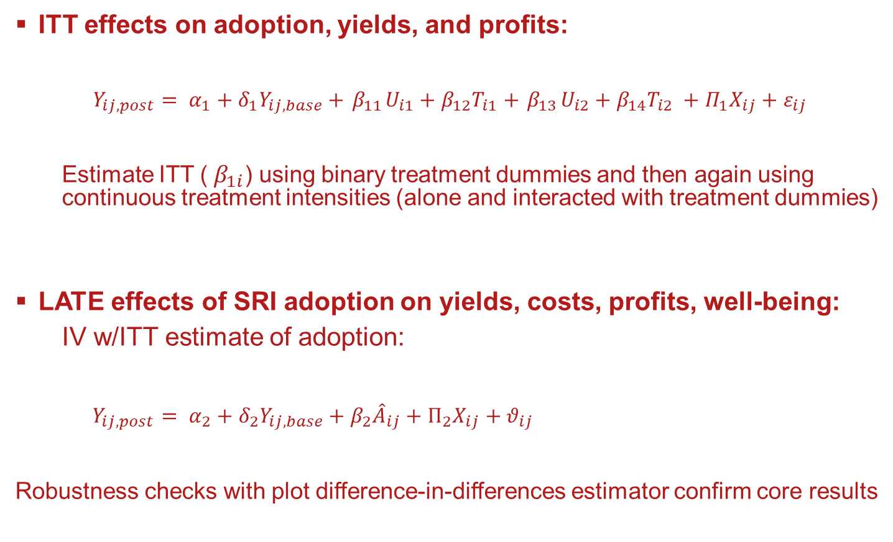
Core empirical strategy: hh-level ANCOVA
ITT effects on adoption, yields, and profits:
$$Y_{ij,post}= α_{1}+δ_{1}Y_{ij,base}+{ β}_{11}U_{i1}+{β_{12}T}_{i1}+{ β}_{13}U_{i2}+{β_{14}T}_{i2} +Π_{1}X_{ij}+ε_{ij}$$
  Estimate ITT (${ β}_{1i}$) using binary treatment dummies and then again using continuous treatment intensities (alone and interacted with treatment dummies)
LATE effects of SRI adoption on yields, costs, profits, well-being:
  IV w/ITT estimate of adoption:
$Y_{ij,post}= α_{2}+δ_{2}Y_{ij,base}+β_{2}{\hat{A}}_{ij}+Π_{2}X_{ij}+θ_{ij}$
Robustness checks with plot difference-in-differences estimator confirm core results

Slide 10
Endline ITT ANCOVA estimates by treatment arm
SRI training has positive and significant adoption effects across the board
Strong spillover effects on untreated farmers in training villages
ITT effects on adoption increasing in intensity of exposure (C=0<U1<U2<T1<T2)
ITT effects on outcomes statistically indistinguishable among treatment arms
 | % SRI Adoption | Yield | Revenue | Total cost | Profit
One-time untreated (U1) | 9.5*** | 0.14*** | 0.17*** | 0.13*** | 0.21*
One-time treated (T1) | 38.7*** | 0.15*** | 0.17*** | 0.16*** | 0.22*
Two-time untreated (U2) | 12.4*** | 0.15*** | 0.17*** | 0.14*** | 0.29*
Two-time treated (T2) | 52.5*** | 0.17*** | 0.18*** | 0.16*** | 0.34***
Baseline outcome |  | 0.22*** | 0.21*** | 0.02 | 0.26***
Observations | 10,286 | 8,626 | 8,626 | 8,626 | 8,626
p-value (U1-T1) | 0.00 | 0.82 | 0.94 | 0.18 | 0.86
p-value (U1-U2) | 0.37 | 0.87 | 0.95 | 0.70 | 0.61
p-value (T1-T2) | 0.01 | 0.50 | 0.70 | 0.93 | 0.36
p-value (U2-T2) | 0.00 | 0.28 | 0.53 | 0.66 | 0.54
Results qualitatively identical using continuous treatment intensity, w/plot-level diff-in-diff, w/correction for multiple hypothesis testing, etc.

Slide 11
Nonlinear exposure intensity effects
ITT treatment intensity effect emerges > median (0.6) saturation. Effects concentrated among for T1 and U2 farmers (o/w no sig impact among U2).

Slide 12
LATE ANCOVA estimated effects of SRI adoption
Using the ITT estimate of SRI adoption as a first stage in the IV, we find:
SRI has big positive impacts on rice yields, costs and profits, consistent w/observational literature.
 | Ln(Rice Yield) | Ln(Rice Profit) | HH savings | HH food security | HH life satisfaction
Adopted SRI (IV=Treatment status) | 0.24*** | 0.47*** | 0.61*** | 0.58*** | 0.38**
Baseline outcome | 0.24*** | 0.29*** | 0.05*** | 0.03 | 0.07***
Control group mean | 3.06 | 5.69 | 84.38 | 4.59 | 7.38
1st stage F stats all >115. Results qualitatively same under continuous treatment and plot diff-in-diff.
Caution: Recall the uniform ITT estimates … do exclusion and SUTVA really hold?

Slide 13
Any GE effects?
One might naturally worry about general equilibrium impacts on labor and/or rice markets. That could compromise LATE estimates by violating exclusion restriction.
No wage rate effects. No sig rice price effects (and, if any, appear negative, reinforcing results).
(N=182 villages)
 | Endline wage rate | Endline rice price
Fraction sample trained | -17.08 | -1.09*
One-time training village | -0.38 | -0.14
Two-time training village | 0.26 | -0.02
Control village endline mean | 340.32 | 15.06
Adjusted R² | 0.323 | 0.250
13 SRI Bangladesh January 2021

Slide 14
Insights from non-random selection into SRI uptake
Information RCTs: might there be heterogeneous treatments? If info induces selection but improves performance regardless of adoption decision, violates SUTVA and exclusion restriction.
Also, likely positive selection on unobservables (e.g., skill, water control) – those likely to benefit most are most likely to adopt conditional on intensity of training exposure. Hence the inverse relation between exposure intensity and cohort-specific ILS LATE estimates.
We find no significant heterogeneity in estimated returns based on any observables other than baseline rice profit, which is a function of unobservables.
Given positive selection on unobservables, added uptake stimulated by more intense training exposure should occur mainly among less ‘skilled’. Training generates largely a scaling effect but not an average productivity effect.

Slide 15
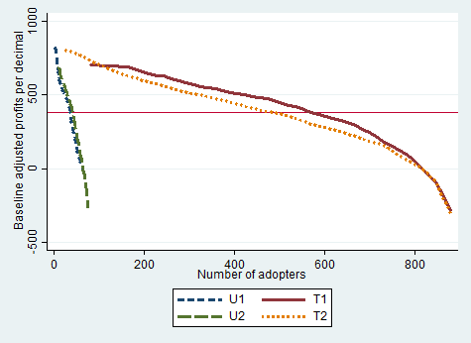
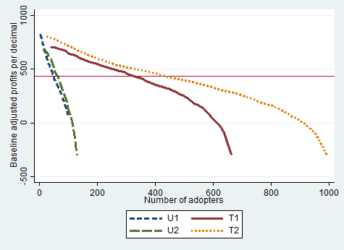
Insights from non-random selection into SRI uptake
And that is precisely what we see …
Ordered profits by treatment status (red horizontal line is control group mean)
Midline Endline
U1/U2 not more profitable with SRI than T1/T2 … must be spillover to non-adopters.

Slide 16
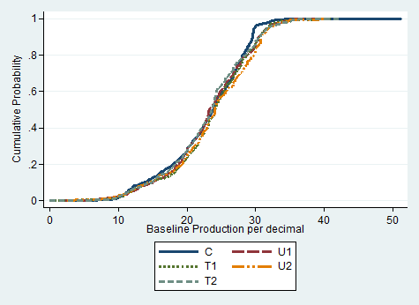
Insights from non-random selection into SRI uptake
No stochastic dominance b/n C&T at baseline.
Another sign of spillovers: FOSD of control group by all training-exposed farmers at midline (and continues at endline), but no dominance among treatment arms.

Slide 17
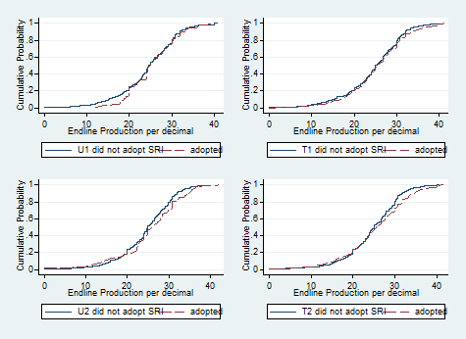
Insights from non-random selection into SRI uptake
No stochastic dominance at endline b/n adopters and non-adopters w/n treatment groups.
p-values decrease w/
exposure intensity (and
adherence to training
weakly improves w/
exposure intensity).
Farmers make reasonably
rational SRI uptake decisions
w/n each treatment cohort.
There must be spillover to
non-adopters from info RCT.

Slide 18
Disadoption and Delayed Adoption of SRI
SRI use stable at 32-33% @ midline/endline, w/churn:
Disadopters (36% of midline adopters):
Disadoption likelihood falls with training exposure intensity (22% for T2)
Relatively older and less educated, with more land.
Had highest midline cost of production.
Had smaller midline gain in profits (29%) vs. persistent adopters (53%).
Delayed Adopters (12% of midline non-adopters):
Delayed adoption likelihood increases with training exposure intensity
Lower midline production than persistent adopters.
Never Adopters (55% of sample in training villages):
Significantly lower baseline costs/higher profits, better off than adopters.
Possibly had little (least?) to gain from adoption of the SRI.
Persistent Adopters (21% of sample in training villages):
Had largest (smallest) midline-baseline Δprofits (Δ costs)

Slide 19
Disadoption and Delayed Adoption of SRI
Directly trained farmers far more likely to try (right away, or w/delay) SRI. Most intensively trained much less likely to disadopt.
Multinomial logit coefficient estimates
 | vs. Never adopters |  |  | (vs. Persistent)
 | Disadopter | Delayed adopter | Persistent adopter | Disadopter
One-time treated (T1) | 2.81*** | 1.62*** | 3.11*** | -0.49
Two-time untreated (U2) | 0.34 | 0.53 | -0.07 | 0.26
Two-time treated (T2) | 2.00*** | 1.95*** | 3.42*** | -1.60***
Ln baseline output | 0.56* | -0.53** | -0.31 | 0.93***
Observations | 2,562 | 2,562 | 2,562 | 8536

Slide 20
Conclusions
About SRI:
Higher intensity of SRI training exposure in both cross-section and time series has big + (-) effect on uptake (disadoption).
Exposure to SRI training significantly boosts rice yields and profits and hh well-being.
ITT/LATE of SRI adoption on rice yields (14-17/24%) or profits (21-34/47%) and household well-being outcomes are consistently positive and relatively large.
Highly non-random selection-on-unobservables into SRI adoption. Exposure mainly has a scaling effect.
W/n treatment arm, adopters-nonadopters indistinguishable by outcome. So selection-on-unobservables appears quite rational.
Also high rates of disadoption. Intertemporal selection likewise seems quite rational.
General: Our results support observational lit on SRI

Slide 21
Conclusions
About econ methods and models:
Beware heterogeneous treatments when randomizing info. Can easily violate exclusion and SUTVA restrictions.
Think about relevant parameter of interest: ITT or LATE?
Hard to reconcile disadoption or performance invariant to training exposure w/workhorse target-input model. Need to look more to emergent multi-object learning models (Nourani, Gabaix, Hanna et al., Wolitsky, Ghosh, Schwartzstein, etc.).

Slide 22
Thank you for your interest!
We invite your comments and questions:
Chris Barrett – cbb2@cornell.edu
22 SRI Bangladesh January 2021

